Slide 1
Business Letters Punctuations and Styles
LESSON 6

Slide 2
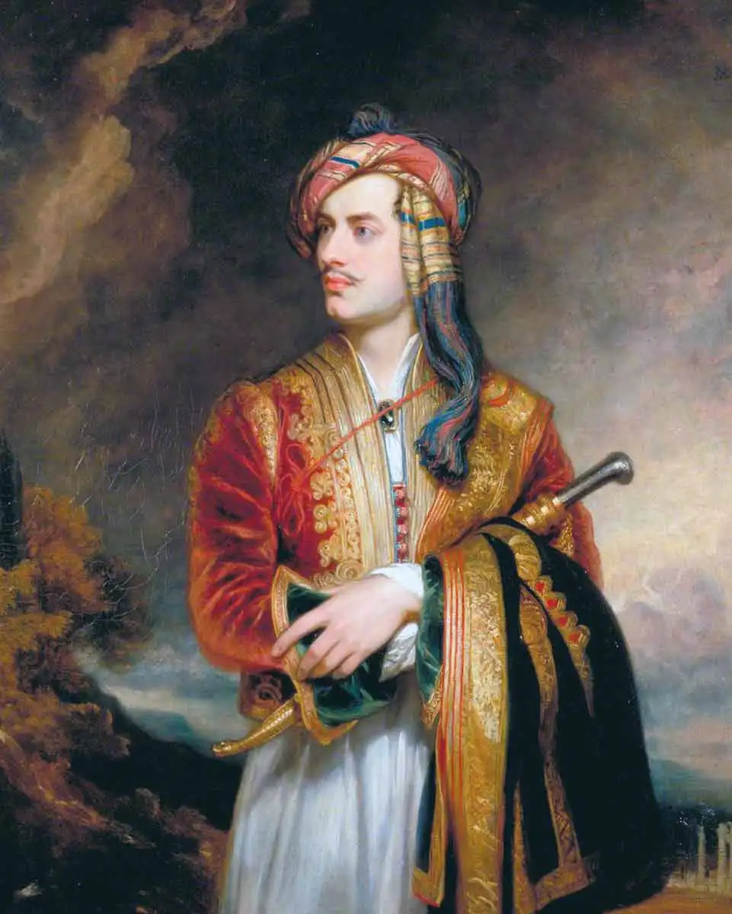
“Letter writing is the only device for combining solitude with good company.”
- Lord Byron

Slide 3
There are different types of business letters that are commonly used in the corporate world. They differ in purpose, style, and nature. Some business letters transmit good news while some transmit bad news. Moreover, some letters of interest to the reader which do not affect the emotion and feeling of the reader are called routine letters.

Slide 4
Writing Good vs Bad- News Business Letters
If the business letter directly affects and stirs the emotions and feelings of the reader, it is either a good or bad news business letter. If you are writing a letter promoting someone from your employee in your company, if you are commending a team in your corporation for beating the monthly sales, you are probably writing a good-news letter. The good-news business letter is light in mood expressing pleasant information.

Slide 5
Unfortunately, there will be times wherein you will be required to write bad-news business letters. If you are writing a letter rejecting a job applicant, if you are writing a thank-you letter for an employee, or worst, writing a letter to fire an employee, you are probably writing a bad-news business letter.

Slide 6

No matter what type of letter you are writing, no matter how good or bad the letter is, always make sure to be professional in writing the business letter. Mind over matter is the rule of the game.

Slide 7
There are common types of business letters such as the following:
Application Letter
This is sometimes called cover letter, and is composed persuasively whenever you are applying for your target job. This letter is usually accompanied by your resume for additional information of your experiences and skills.

Slide 8
In writing your application letter, you may follow this format:
First Paragraph: Determine the reason/s why you are applying for the job. Mention if the job is solicited or unsolicited.
Second Paragraph: Explain why you deserve the job without being too boastful. You may support it by citing your qualifications.
Last Paragraph: Even if you think you are hired or not, thank the hiring personnel.

Slide 9
There are three styles of resume:
Chronological Resume focuses on the employment history of the applicant. This style is ideal for those who already have several work experiences showing steady career growth.
Functional Resume focuses on skills rather than on employment history. This style is ideal for those who are fresh graduates seeking for their first job.
Combination Resume focuses on drawing the best features or strong points of chronological and functional resume styles.

Slide 10
2. Letter of Inquiry
This is a letter that asks for a particular information or assistance. This type of business letter is direct and the questions are constructed to get the information straightforwardly.

Slide 11
In writing a letter of inquiry consider the following guidelines:
First paragraph. Begin with the most important question or a summarizing statement.
Second Paragraph. This part may contain the explanation or list of questions.
Third Paragraph. The ending should tell the reader what you want to be done and when.

Slide 12
3. Letter of Reply or Response
This is written in response to a letter of inquiry which directly answers all the inquiries regarding the company’s products or services. As part of business as usual, most companies promptly reply to all the inquiries addressed to them.

Slide 13
In writing the letter of response, the following steps may help you:
Acknowledge the inquiry by mentioning important details from the letter of inquiry you received.
Build goodwill and pave the way for future contacts by using a cordial or friendly tone.
Answer the questions fully and send prompt replies.

Slide 14
4. Letter of Request
This is commonly used everywhere. We use it daily in academe, in industry, even in corporate world. The main purpose of this letter is to request for something you need.

Slide 15
In writing a letter of request, you may follow these steps:
First Paragraph: (Orientation) This is the introduction part where you begin with the details of the event of any activity. The date, time, and venue should be also indicated.
Second Paragraph: (Information) In this part, you need to mention the requested materials or equipment or even venue. You need to be very specific in this part.
Last Paragraph: (Action) Thank the person in charge to promote good will.

Slide 16
5. Letter of Order
This is one type of business letter which is written for the purpose of purchasing items that are for sale.
An order letter usually contains the following:
Name of the item ordered
Description of each item, giving size, style, finish, quality, material, weight, or whatever will help in identifying the article wanted

Slide 17
c. Catalog number of the item, if it is available
d. Quantity of each item wanted
e. Price of each item and the total price of the order
f. Method of shipment desired by the buyer
g. Address where the goods are to be shipped or delivered
h. Date of shipment
i. Credit references, if payment is made from an account
j. Mode of payment

Slide 18
Qualifications and carter objectives will help you select format of your resume:
Chronological Resume Format includes:
Applicant’s name
Address
Telephone number
Job Objectives
Education
Work history – listed job by job, beginning with the most recent position

Slide 19
2. Functional Resume Format focuses on the applicant’s skills rather than on previous employment.
3. Combination Resume Format highlights the best features of 1 and 2 emphasizing the applicant’s capabilities while also including a complete job history and is recommended for fresh graduates.

